Slide 1
Predicting Employee Promotion
Presented By:
Vikas Dutta

Slide 2
Overview:
The given dataset gives us information on the employees and their records from which we have to analyze employee's performance and predict their promotion eligibility.
The aim is to analyze the various factors that can contribute to the promotion of an employee. Based on the analysis, predict which employees will be promoted.
Here we have “['employee_id', 'department', 'region', 'education', 'gender','recruitment_channel', 'no_of_trainings', 'age', 'previous_year_rating','length_of_service', KPIs_met>80%'awards_won?','avg_training_score', 'is_promoted']”
as Features in our Dataset and “is_promoted” as our Target Variable which is binary and specifies whether the employee was promoted or not.
So we need to perform EDA to get insights from data and build a M.L model to predict their promotion eligibility.

Slide 3
Exploratory Data Analysis &PRE-PROCESSING OF DATA:
Some of the insights that we can get from EDA are-
Percentage of Promoted Employees is 8.52%.
A very small set of employees have actually won awards i.e 1270 people.
Various companies have been reported to be gender bias. It is good to be sure if such case exists for the company under analysis, this can gives markers for predictions later on. For the dataset under analysis, the number of male employees are more than double the female employees.But Opposite to the assumption, the females have more promotions as compared to the males. The pie charts concludes that the two genders have equal proportions of promotions. This does not mean that equal number of females and males were promoted. As established earlier, the population of males is far greater than female. The proportions calculated are with respect to their population.
The *KPIs_met* and *awards_won* columns are inconclusive individually in the count plots.
The combined plot which shows the distribution of *is_promoted* for all employees who have both won and award and met the KPIs is however very helpful. The conclusions drawn :-
A less percentage of employees who were promoted have won award.
An employee who meets the targets has a high chance of promotion.
Employees who have both won the award and met targets are likely to be promoted.

Slide 4
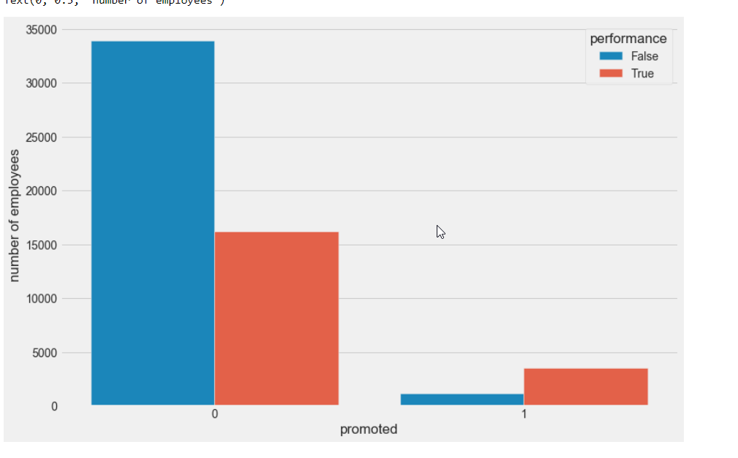
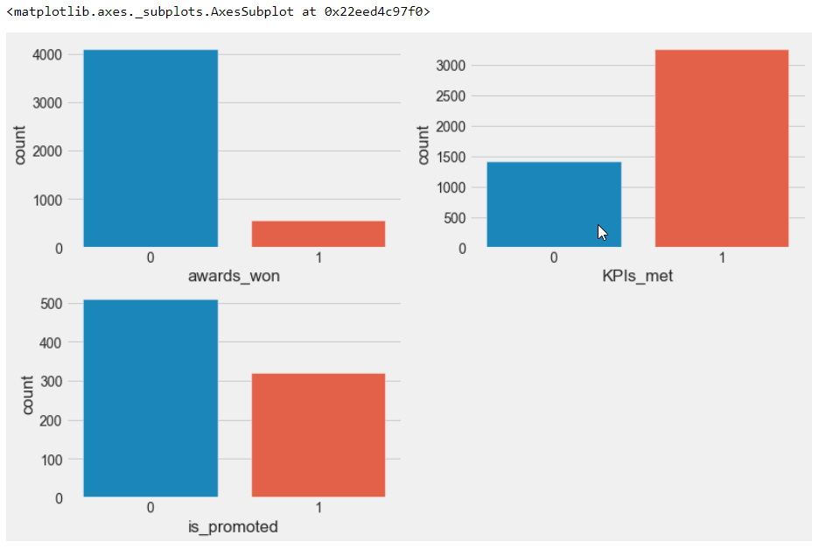
Comparision of counts of performance of employees who were promoted and and performance of employees who werenot promoted
The first two plots convey the distribution of awards_won and KPIs_met respectively for the employees who were promoted.
The third plot shows the distribution of is_promoted for all employees who have both won and award and met the KPIs.

Slide 5
The columns no_of_trainings and avg_training_score specify the number of company organized workshops and trainings has the employee attended and the average training score the employee recieved for the said trainings. Trainings and workshops are integral for an employee as they are hosted for skill development of the employees. These trainings scores help the company understand which employees are improving. The two columns individually do not provide a good assessment since they cannot be compared between employees.
The two above scenarios give rise to a third column - total_score, which gives an estimate of the total score recieved by an employee. This column is a good factor to compare and differentiate between employees who have shown improvement and those who haven't.
The total_score column is on the ratio scale i.e. is numeric. The aim is to compare the total_score with the is_promoted column to identify if any relationships exist. For this purpose the total_score column is divided into 3 bins (categories) :-
Low - 65 or lower
Mediocre - 65 to 145 points
High - 145 or higher
The bins have been selected based on the distribution of the total_score column for the employees that were promoted. Using the pd.cut() functions the column is split into bins and stored in total_score_label column for further analysis.

Slide 6
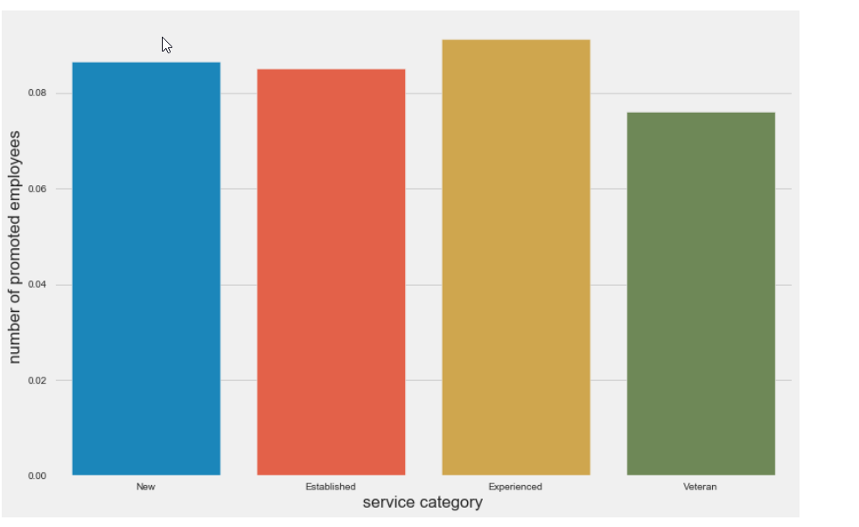
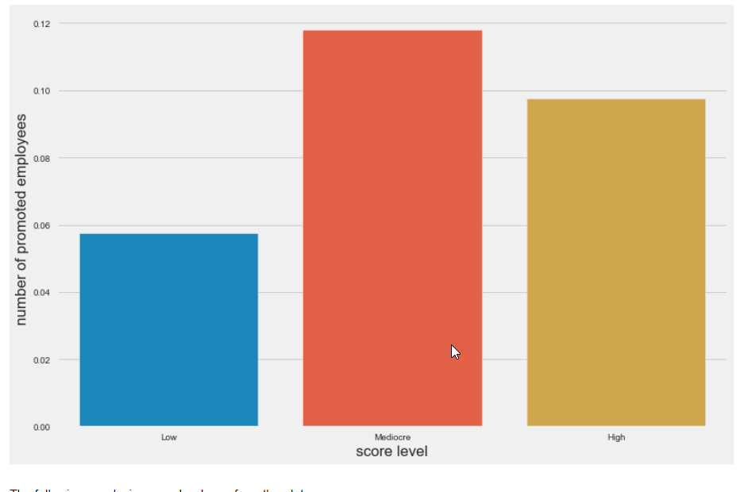
Length of service and %ge of promoted employees
The bins have been selected based on the distribution of the total_score column for the employees that were promoted.i.e LOW,MEDIUM,HIGH

Slide 7
A similar approach is taken for the *length_of_service* column. An employee who has been in a company longer is more likely to be promoted rather than a new joinee. Since the column is numeric, it is converted to categorical via binning into the following categories.
* New - 0 to 2 years *Established - 2 to 7 years *Experienced - 7 to 10 years *Veteran - 10 years or more
The plot concludes that :-
Experienced employees are likely to get promoted than other categories, due to their experience and understanding of the company.
New and Established employees have almost equal likelihood of getting promoted.
Veteran employees generally get less promotions. Due to their number of years given to the company, majority of them might have reached the pinnacle.
The age column is very similar to the service length, in terms that both define a temporal factor for the employee. The column is numeric. Assuming that an employee's career starts at the age of 20, and hence is binned into the following categories :-
*Young - Less than 25 years *Middle - 25 to 40 years *Senior - 40 to 50 years *Elder - 50 years or older
The plot clearly states the following :-
An employee aged between 25 and 40 years is likely to be promoted.
A senior employee aged 40 to 50 years has a good chance of getting promoted.
A Middle aged or Senior employee form the perfect age interval (25 to 50) where an employee is said to at the peak of his/her career.
Younger or Elder employees have lesser chances of being promoted as the former has just begun their career and the latter is coming towards an end to their career.

Slide 8
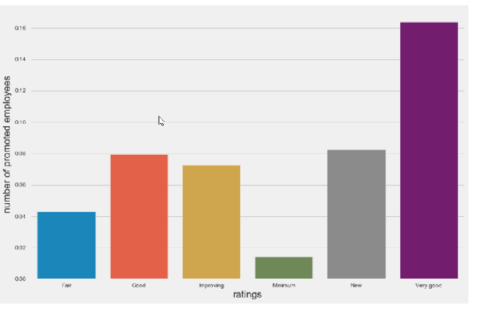
The previous_year_rating describes the rating an employee recieved in the internal evaluations of the company in the previous year. These ratings give a clear differentiation between employees. By intuition, an employee with a good rating paired with other factors is likelier to be promoted. To prove this hypothesis, the previous_year_rating column is first encoded into labels for understanding.
The plot proves the hypothesis coined earlier.
Employees with 'Very good' rating (5) are most likely to be promoted.
The trend in the number of people promoted is upwards from 'Minimum' to 'Very good' rating.
'New' (no previous year rating) employees shows good percentage of people being promoted. For these employees, other factors are dominant.

Slide 9
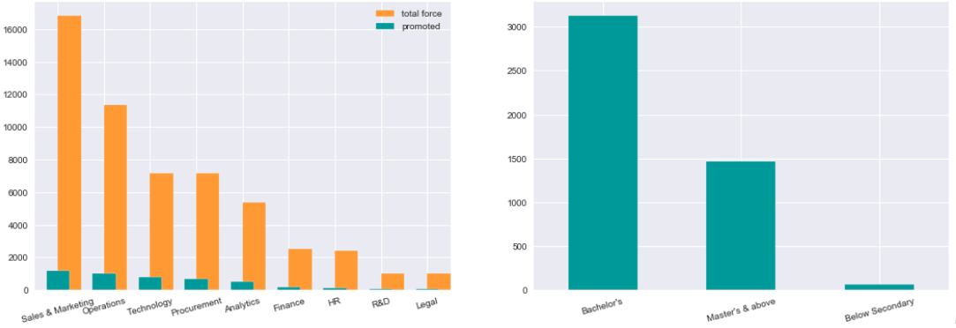
Promotion on the basis of Department and Education
The last columns to analyze are the department and education.
The Sales & Marketing team has the highest number of promoted employees according to the bar plots, this can be because the Sales & Marketing team also has the highest total of employees.
From the promoted employees, most of them hold a Bachelor's qualification. Bachelor's qualification is also the most frequent in the data and hence this can be accounted for.
Across the different departments, the percentage of employees promoted are very close to each other.
These conclusions prove that department and education are indecisive when it comes to promotion.

Slide 10
The extensive analysis conducted, led to the following conclusions on this dataset :-
The performance column which is an amalgamation of KPIs_met and awards_won is a good factor to predict which employees get promoted, but it is not the only factor.
The average training score and the number of trainings attended combine to give the total training score. Employees with Mediocre or High score are likely to be promoted.
Gender as a factor has no effect on the promotions of the employee, both the genders had about equal percentages of representatives from the two sets.
The Age and Service categories give a temporal factor for the employees. Employees who are Middle aged and Established or Experienced have high chances of being promoted. The other categories within these proves that Age and Service length are not the only factors affecting promotion.
The most important factor amongst all is the previous year rating the employee recieved. The chances of promotions increase as the rating increases for an employee. New employees, that have 0 ratings also have a chance at promotion as, these ratings are not the only contributing factor.
Department and Education of an employee hardly gives much insight into which employee is likely to be promoted.

Slide 11
FINAL CONCLUSIONS ON FEATURES REQUIRED:
From the above conclusions, it can be said with confidence that no factor alone is responsible for the promotion of an employee. The following factors together can be considered for predictive modeling.
performance
age
service length
previous year rating
total score
The rest of the factors are removed from the dataset.

Slide 12
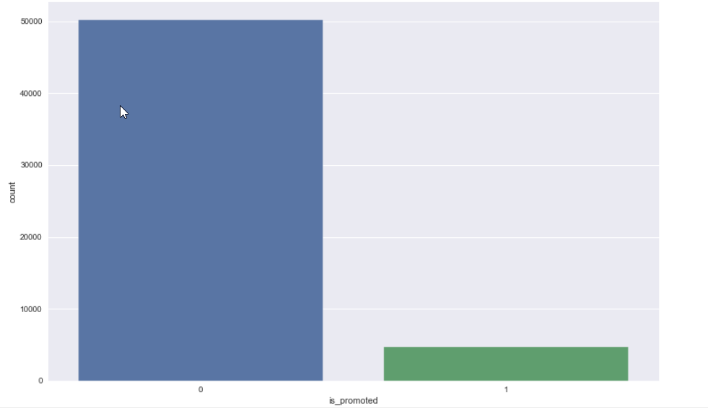
Tackling Imbalanced Class
The dataset has a huge imbalance in the target classes. Training a classifier on imbalanced classes can prove problems in precision and recall of the model. Depending on which class is lesser than the other :-
To overcome this problem, two solutions are suggested. Either the dataset is undersampled to match the classes or the dataset is oversampled and the class with lesser representatives is increased. Undersampling can cause loss of data and in this case since class 1 has only 4668 data points, the total depth of the data would be reduced to around 9000. Effectively the model would lose 41000 data points. Oversampling seems like the better option. The function RandomOverSampler from imblearn.over_sampling module is used.
There are two scenarios:
1.low recall + high precision : the model can’t detect the class well but is highly trustable when it does.
2.high recall + low precision : the class is well detected but the model also include points of other classes in it.

Slide 13
TRAINING MACHINE LEARNING MODELS
Cross Validation:
Using the sklearn.model_selection - cross_validate function, the entire dataset will be cross-validated on the entire dataset to see how the model performs on this dataset. The cross validation gives a good method for model selection. The model which performs good on cross validation is then chosen for further training, testing and hyper-parameter tuning. The ML model chosen here is GradientBoostingClassifier.
Cross-validation on the resampled dataset shows excellent results. The average Test set accuracy is about 87% with precision and recall around the same neighbourhood. f1 scores give a holistic view of the precision and recall, which is very good in this case, about 88%. Thus it can be concluded that the GradientBoostingClassifier is a good predictor for this dataset.
The next step is hyper-parameter tuning. This tunes the parameters of the model to the best set that can maximize the accuracy of the model. Letting the learning rate be fixed at 0.1, the max_depth of the trees (estimators) will be varied between 10 and 25 to get the optimal value. For this parameter a validation curve is made.

Slide 14
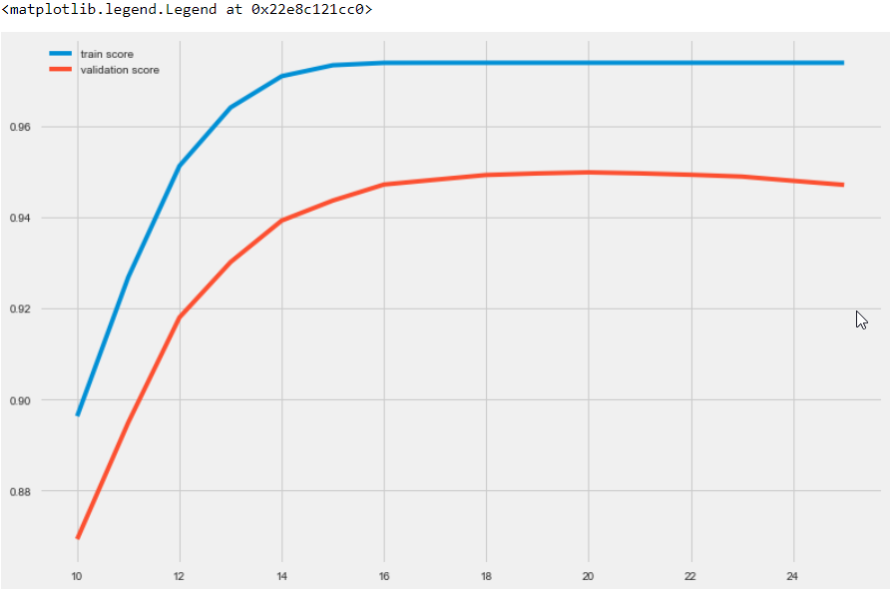
VALIDATION CURVE
The validation curve is a plot of the train and test accuracies vs a parameter under optimization.
The validation curve for the test accuracy identifies the optimal value of max_depth for classifier. In this case the max_depth value of 20 yields a average test accuracy of 94.94%. This accuracy is quite good and shows that the model has learnt the classes well and is highly trustable in its predictions.

Slide 15
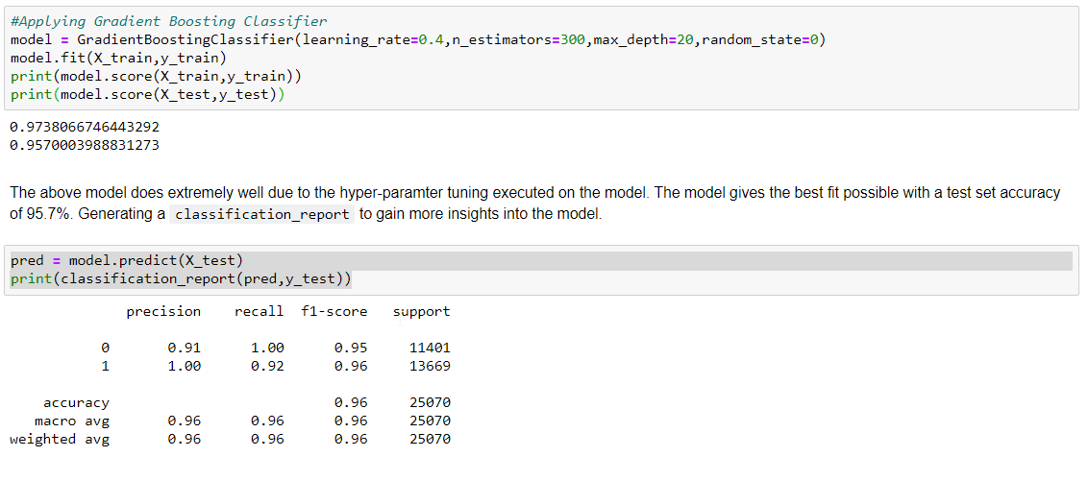
1.GradientBoosting
The GradientBoostingClassifier has many parameters such as learning_rate, max_depth, n_estimators etc. When the best value for these have to be found together, GridSearchCV is used. For every combination of these parameters cross validation is performed. The combination giving the best score is returned along with the parameters in the combination.
After performing a Grid search the optimal paramters for the model are returned. Using these parameters, the model is finally trained on the train set and tested as well as make predictions on the test set. This model becomes the final output from the analysis.
This model is a good classification model and removes any bias in the data. It is robust to over fitting. Since it uses ensemble techniques, various trees are used as predictors. One tree can develop bias, but the combination of outputs of many trees give a stable result.

Slide 16
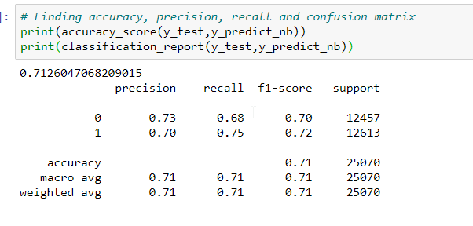
Naive bayes Bernouli
Bernoulli Naive Bayes is a variant of Naive Bayes.Naive Bayes is a classification algorithm of Machine Learning based on Bayes theorem which gives the likelihood of occurrence of the event. Naive Bayes classifier is a probabilistic classifier which means that given an input, it predicts the probability of the input being classified for all the classes. It is also called conditional probability.
This is used for discrete data and it works on Bernoulli distribution. The main feature of Bernoulli Naive Bayes is that it accepts features only as binary values like true or false, yes or no, success or failure, 0 or 1 and so on. So when the feature values are binary we know that we have to use Bernoulli Naive Bayes classifier.

Slide 17
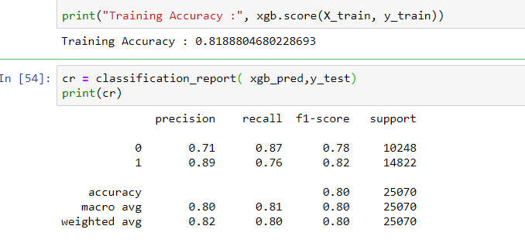
3.Xg-Boost Classifier
XGBoost is a decision-tree-based ensemble Machine Learning algorithm that uses a gradient boosting framework. In prediction problems involving unstructured data
When using gradient boosting for regression, the weak learners are regression trees, and each regression tree maps an input data point to one of its leafs that contains a continuous score. XGBoost minimizes a regularized (L1 and L2) objective function that combines a convex loss function (based on the difference between the predicted and target outputs) and a penalty term for model complexity (in other words, the regression tree functions). The training proceeds iteratively, adding new trees that predict the residuals or errors of prior trees that are then combined with previous trees to make the final prediction. It's called gradient boosting because it uses a gradient descent algorithm to minimize the loss when adding new models.
Gradient boosting is a supervised learning algorithm,
which attempts to accurately predict a target variable by
combining the estimates of a set of simpler, weaker models.

Slide 18
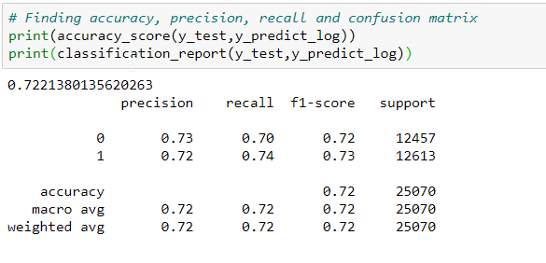
Logistic Regression
Logistic regression is a statistical model that in its basic form uses a logistic function to model a binary dependent variable, although many more complex extensions exist. In regression analysis, logistic regression (or logit regression) is estimating the parameters of a logistic model which is a form of binary regression.
It is used to describe data and to explain the relationship between one dependent binary variable and one or more nominal, ordinal, interval or ratio-level independent variables.

Slide 19
Performance of Models
M.L MODELS | ACCURACY
Gradient Boosting | 95.7%
Naive Bayes Bernouli | 71.2%
XG Boost | 81.8%
Logistic Regression | 72.2%

